Slide 1
Fn_HGFcell
Zhilong Jia
12 June, 2018
18 July, 2018
7 Aug, 2018

Slide 2
Data Description and Proposal
Group | 0h | 2h | 6h | 12h | 24h | 48h
ctrl (C) | (BCDEF)0 | (BCDEF)2C | (BCDEF)6C | (BCDEF)12C | (BCDEF)24C | (BCDEF)48C
FN (F) |  | (BCDEF)2F | (BCDEF)6F | (BCDE)12F | (BCDEF)24F | (BCDEF)48F
DEA at each timepoint (2, 6, 12, 24, 48h)
ChowRuskey plot
PCA, heatmap of unioned DEGs
pathway & GO analysis
pathway & GO analysis of ChowRuskey set
Changes of pathway enrichment (GSEA) via time
time series analysis
PCA, heatmap, pathway & GO analysis of ChowRuskey set and per time span
co-expression analysis
cogena/clusterProfiler pathway/GO analysis, drug repositioning analysis
Enrichment analysis for 24h only

Slide 3
Biological experiments
增殖：1-7d生长曲线
凋亡、周期：2-72h
抑制细胞增殖，促进细胞凋亡，细胞周期（凋亡峰），细胞内活性氧水平升高，细胞免疫（TLR2,TLR4, IL6, IL8, TNFalpha, IL1beta上调， NF-kappa通路（30min激活）， MAPK通路），抑制细胞成骨分化，细胞干性

Slide 4
Biological experiments
The Fap2 surface protein of F. nucleatum ATCC 23726 is a galactose-binding lectin that mediates fusobacterial hemagglutination.

Slide 5
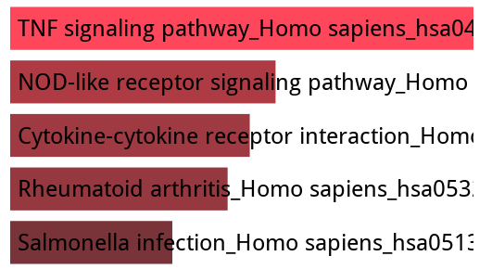
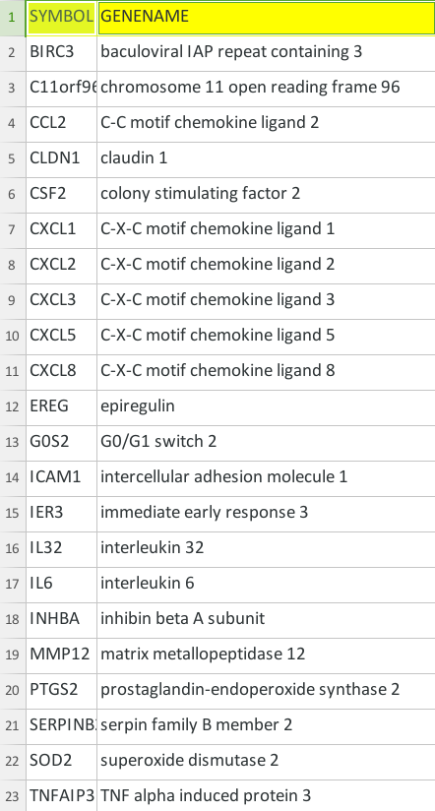
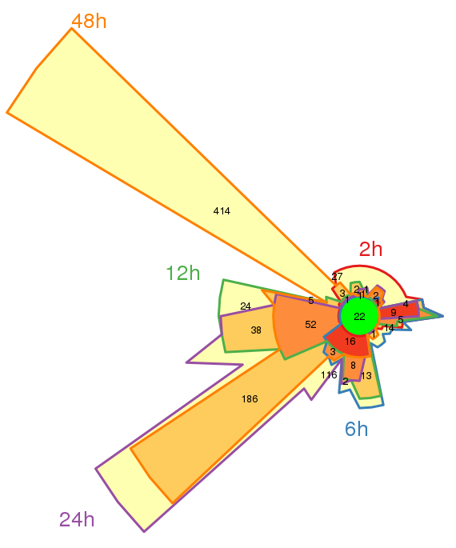
ChowRuskey plot of DEA for each timepoint
22 core
genes

Slide 6
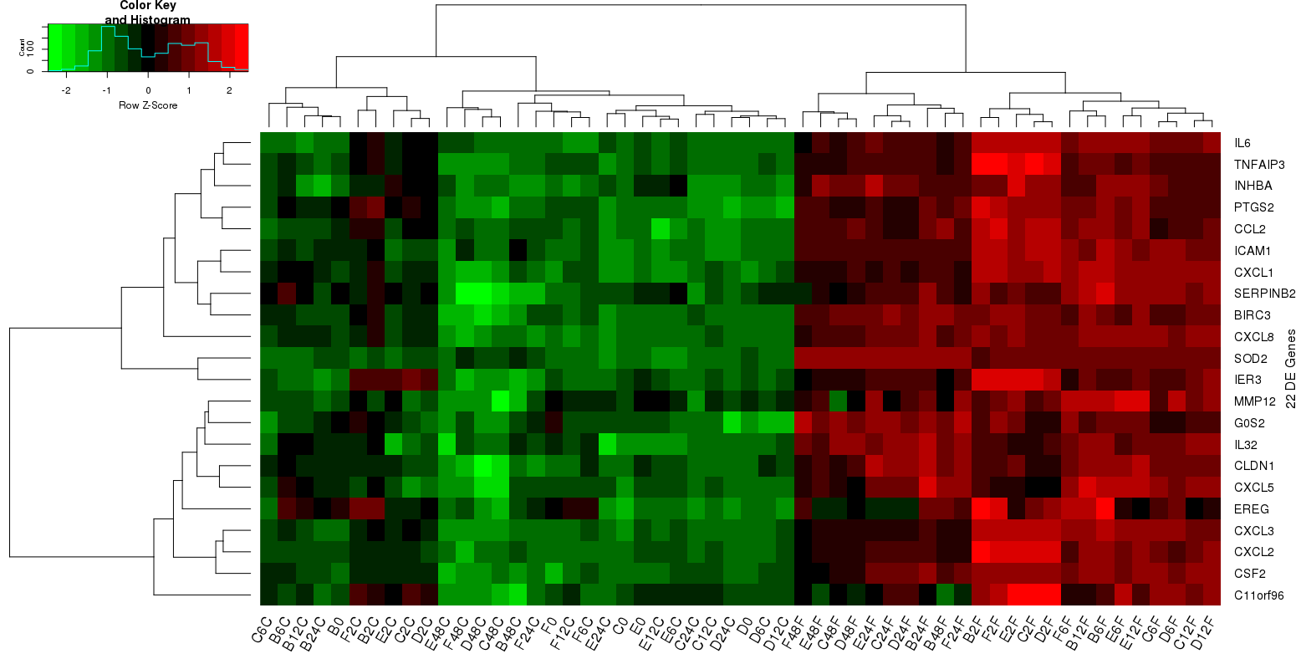
heatmap (Colv=T) of 22 core genes

Slide 7
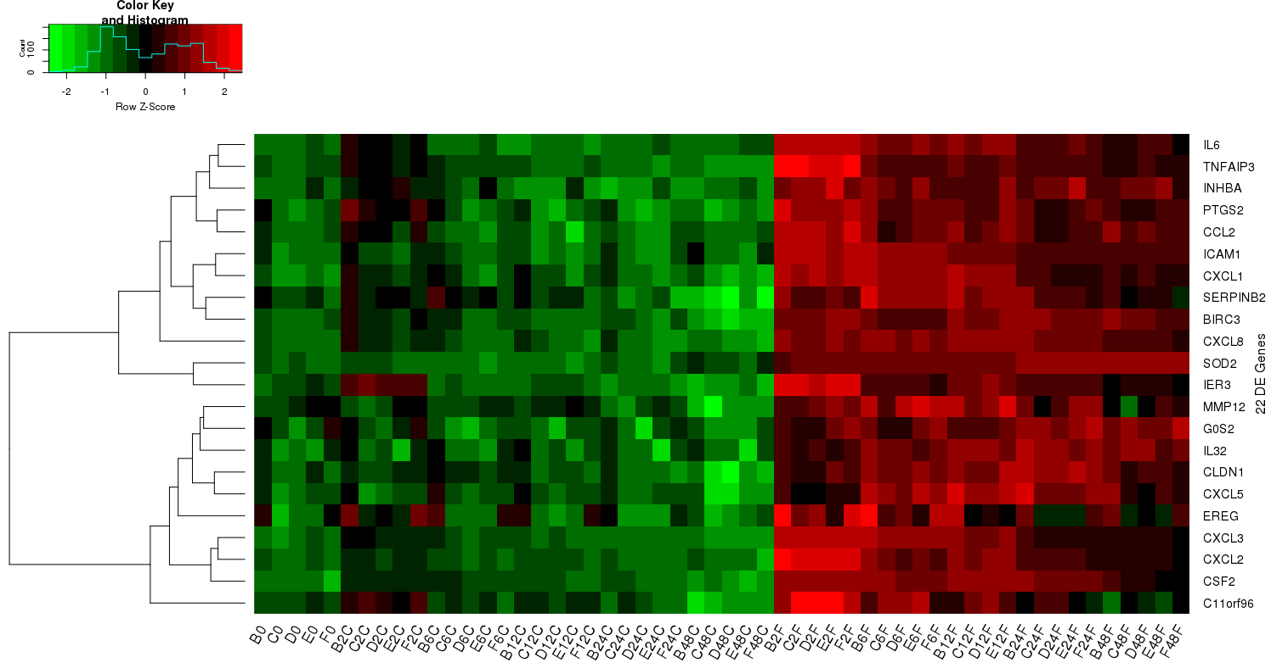
heatmap (Colv=F) of 22 core genes

Slide 8
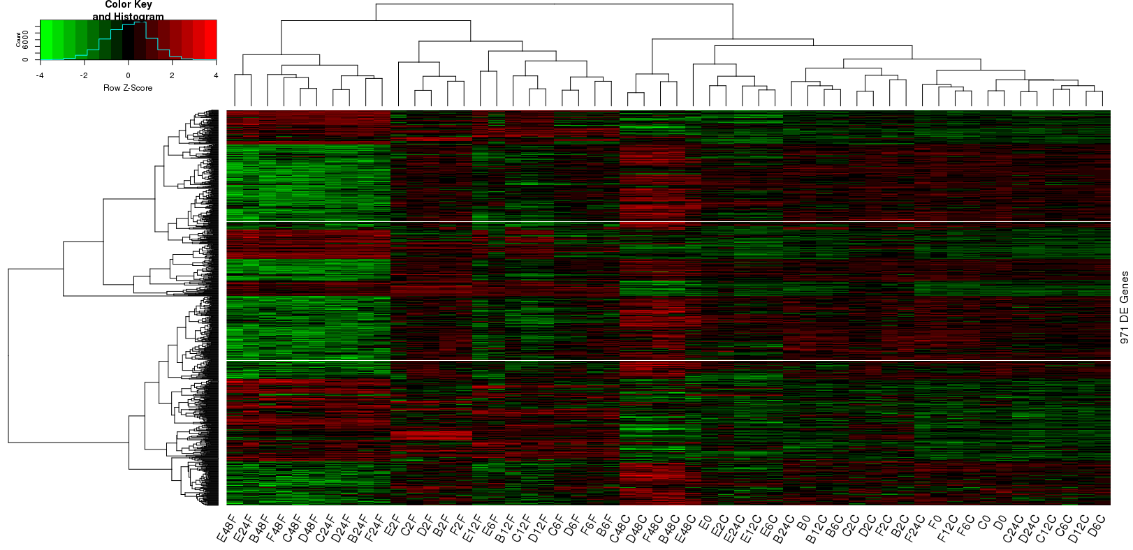
heatmap (Colv=T) of united genes

Slide 9
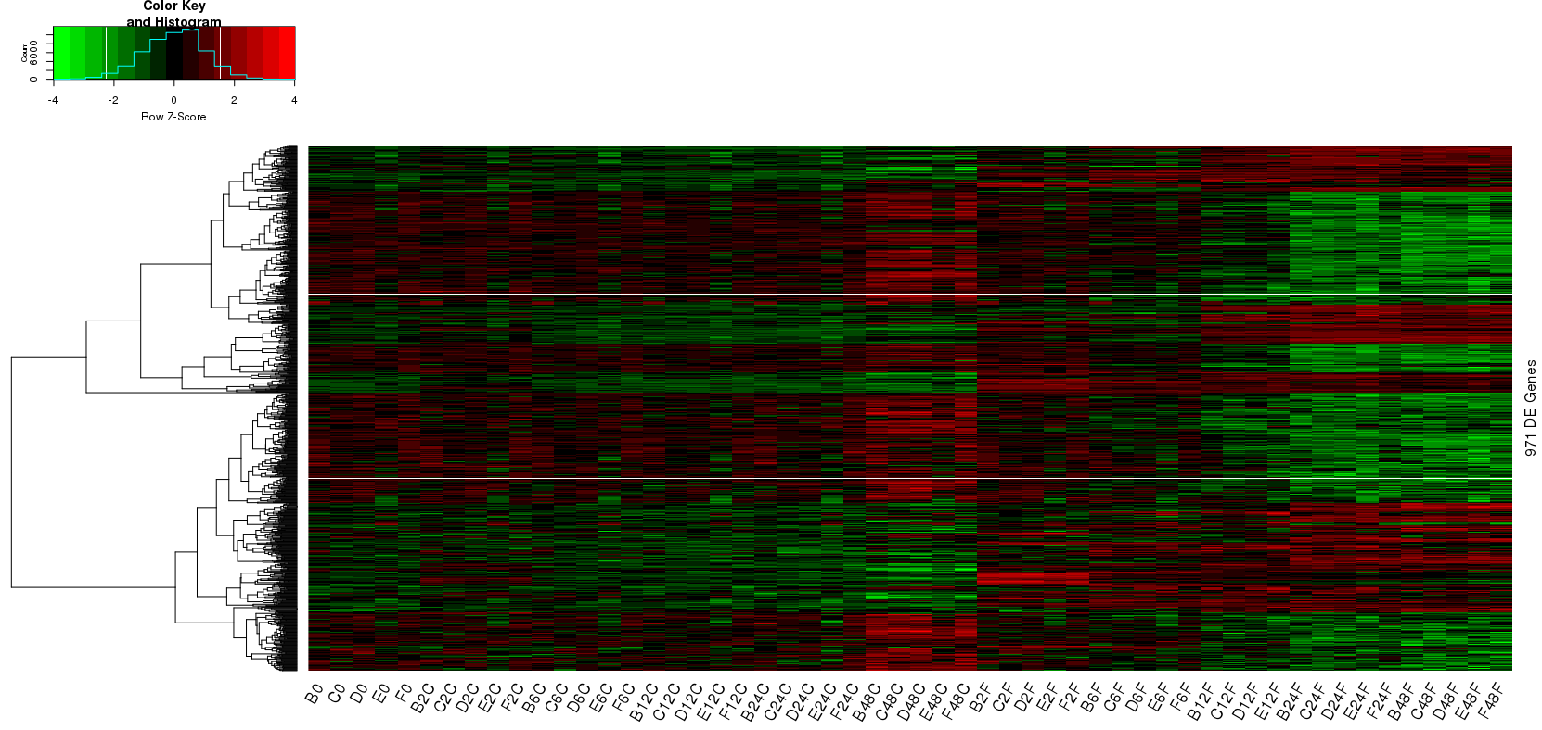
heatmap (Colv=F) of united genes

Slide 10
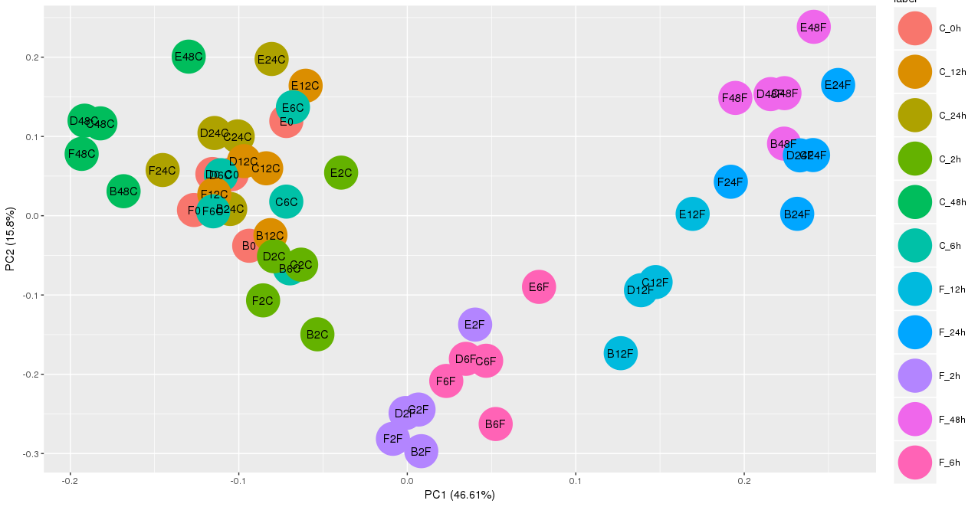
PCA of united DEGs from each timepoint
Cs and Fs, Fs from different timepoints can be clearly separated;
while the ctrl group are individual-specific (next slide).

Slide 11
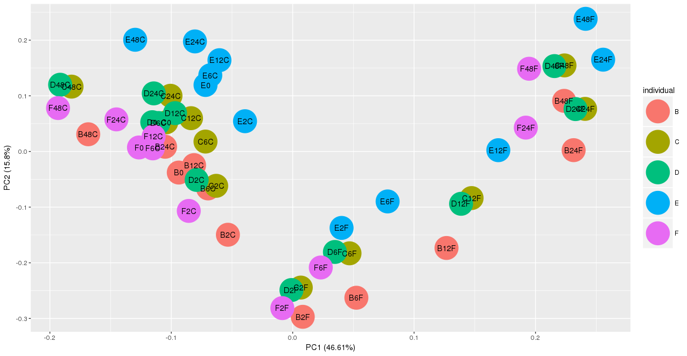
PCA of unioned DEGs from each timepoint
The ctrl group are individual-specific, representing no signaficant changes over time, compared with the Fn (next slide).

Slide 12
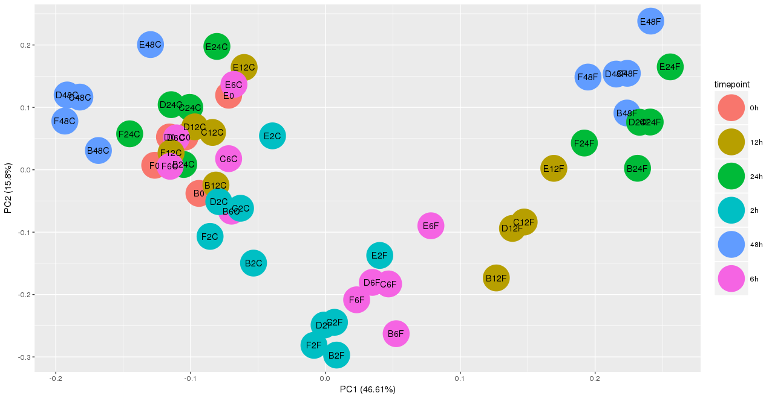
PCA of unioned DEGs from each timepoint
The ctrl group has no signaficant changes over time, compared with the Fn.

Slide 13
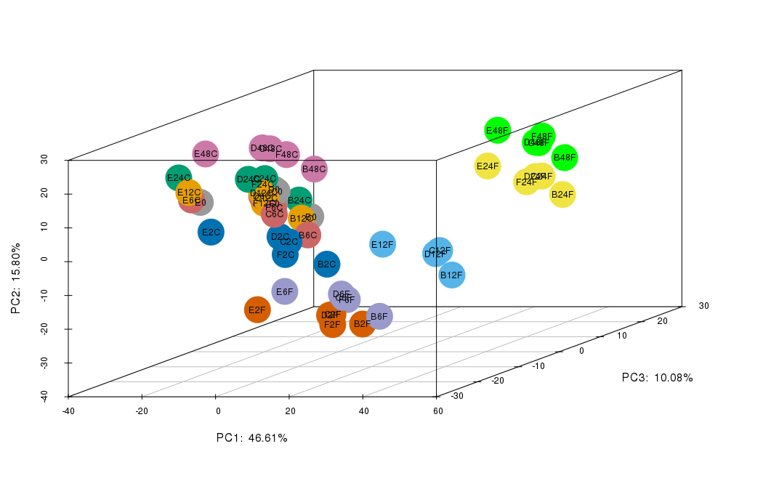
3D-PCA of unioned DEGs from each timepoint

Slide 14
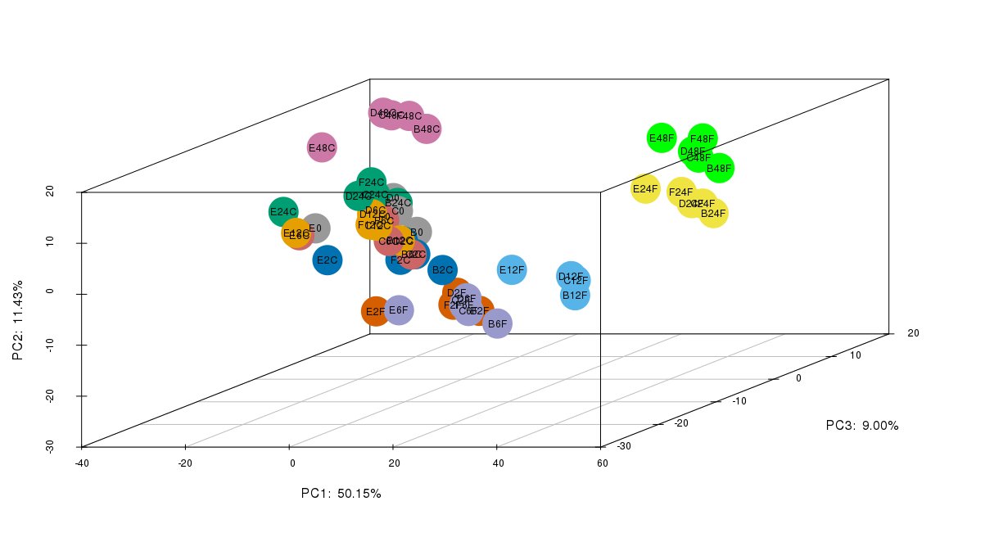
3D-PCA (scaled) of unioned DEGs from each timepoint

Slide 15
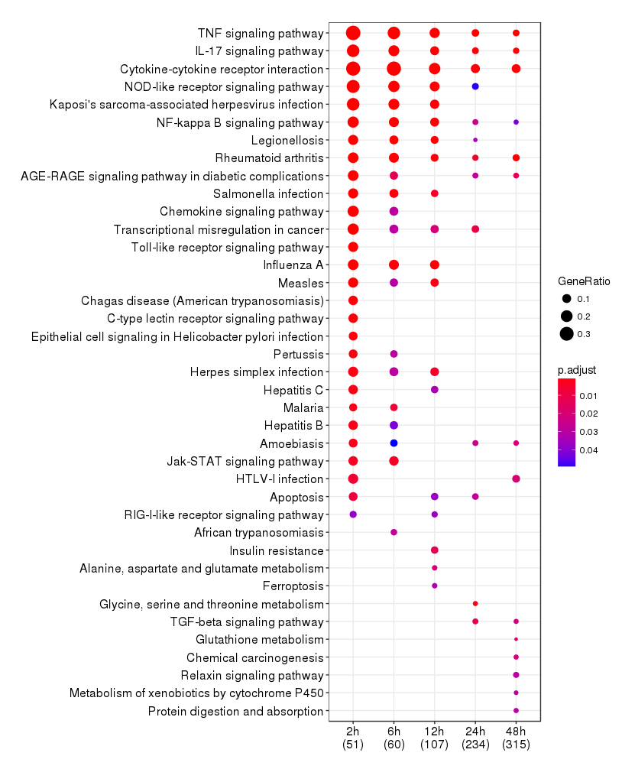
Pathway analysis of DEGs at each timepoint

Slide 16
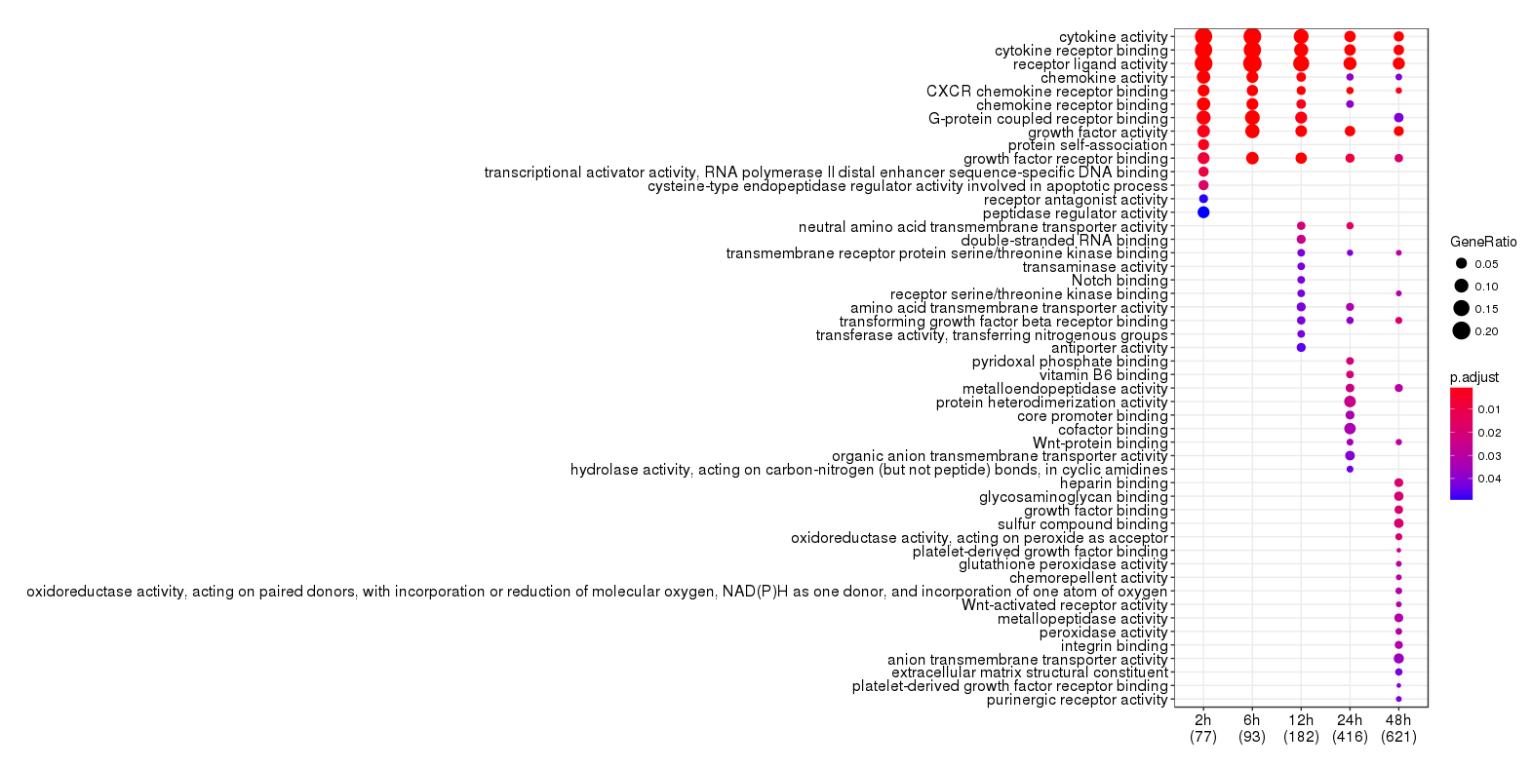
GO analysis of DEGs at each timepoint

Slide 17
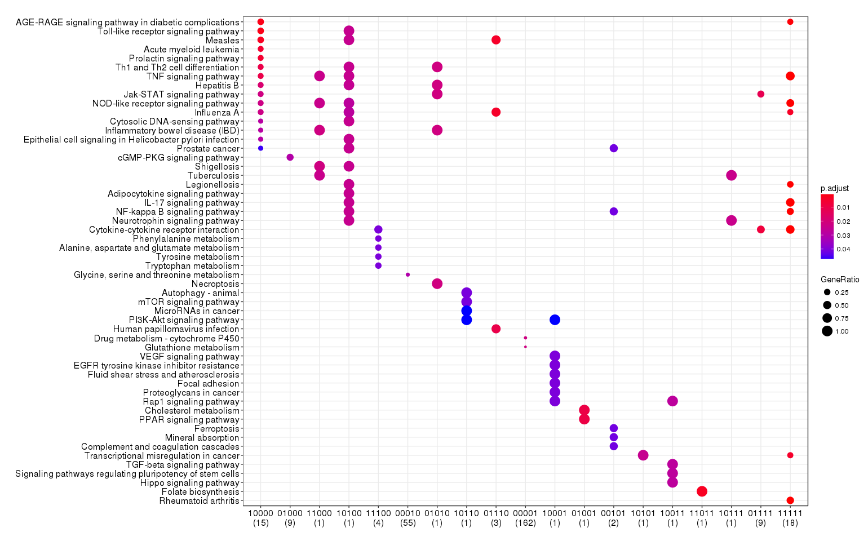
Pathway analysis for each part in ChowRuskey plot
2h, 6h, 12h, 24h, 48h (1: existed; 0: non-existed)

Slide 18
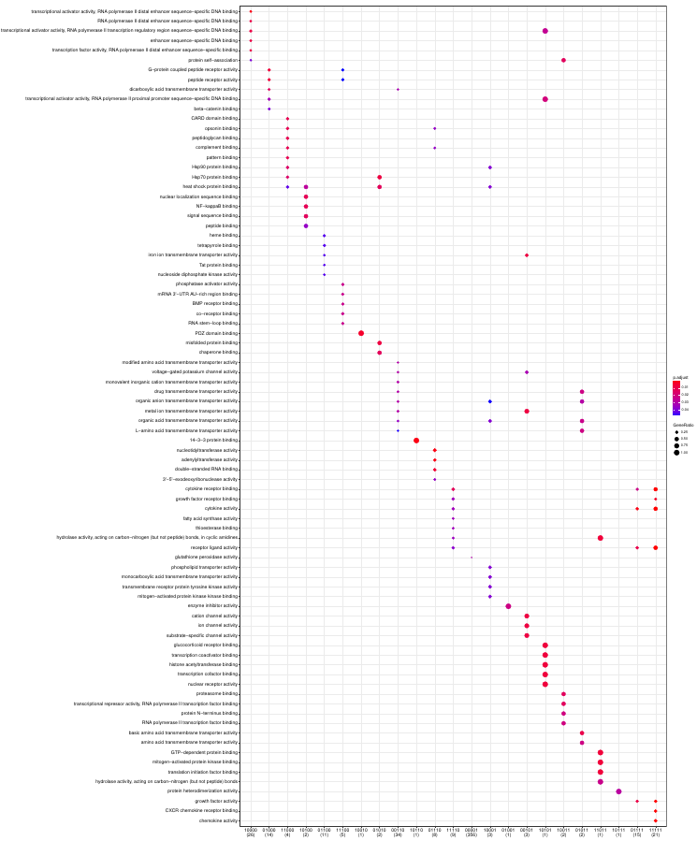
GO analysis for each part in ChowRuskey plot
2h, 6h, 12h, 24h, 48h (1: existed; 0: non-existed)

Slide 19
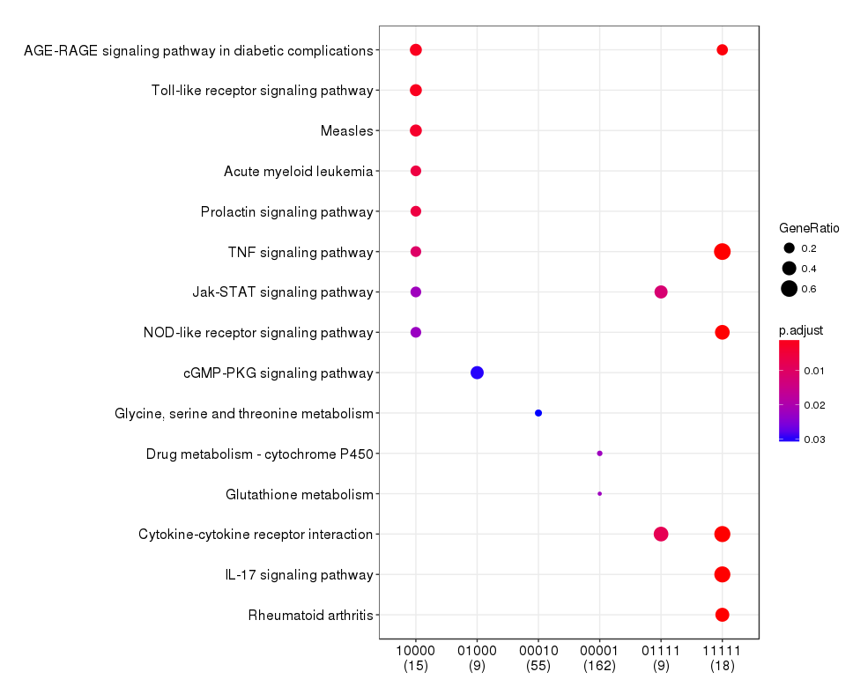
Pathway analysis for each part in ChowRuskey plot (filtered)
2h, 6h, 12h, 24h, 48h (1: existed; 0: non-existed)

Slide 20
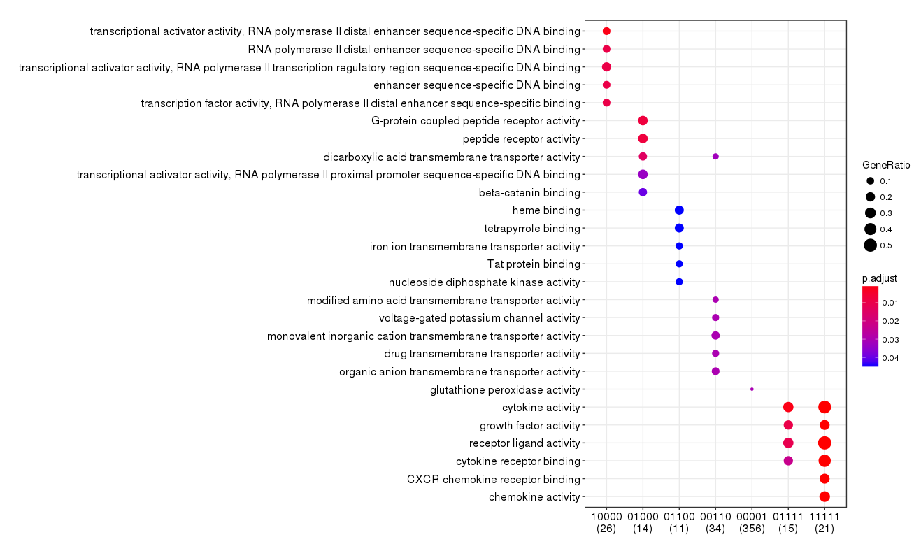
GO analysis for each part in ChowRuskey plot (filtered)
2h, 6h, 12h, 24h, 48h (1: existed; 0: non-existed)

Slide 21
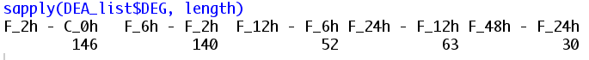
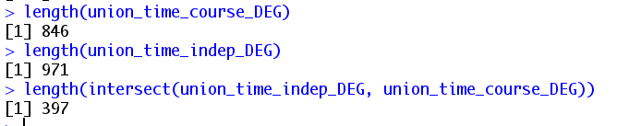
time series analysis
DEGs from Fn group over time comparsion (F_2h - C_0h, F_6h - F_2h, F_12h - F_6h, F_24h - F_12h, F_48h - F_24h)

Slide 22
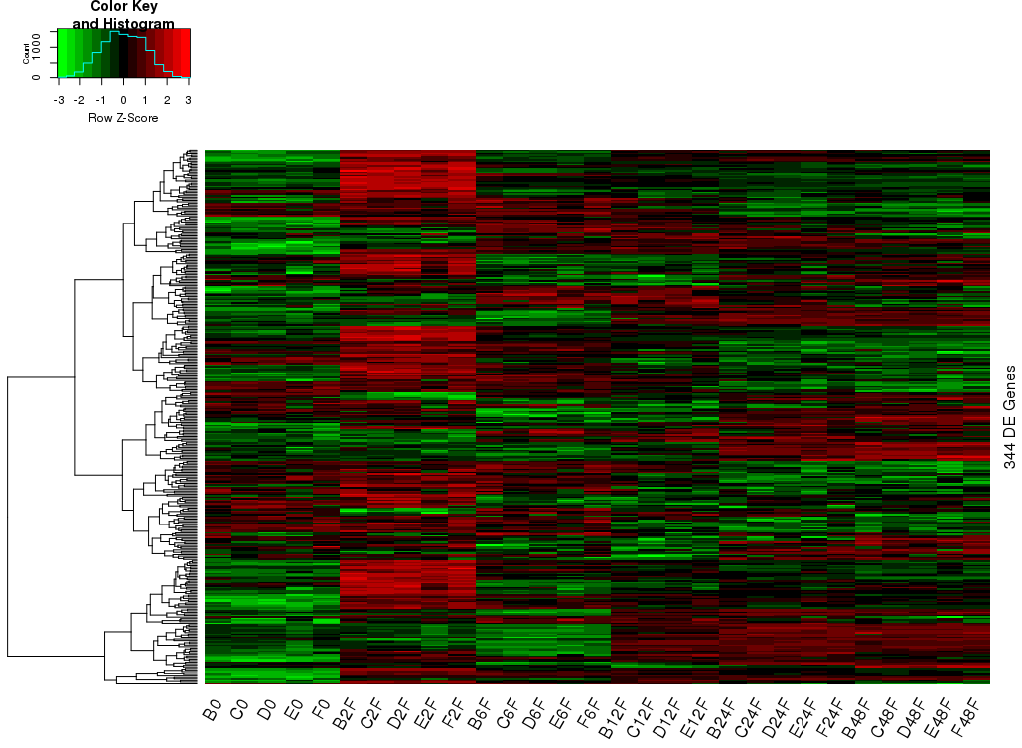

Slide 23
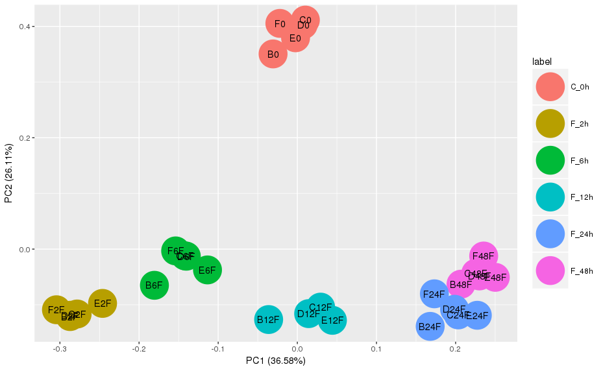
PCA

Slide 24
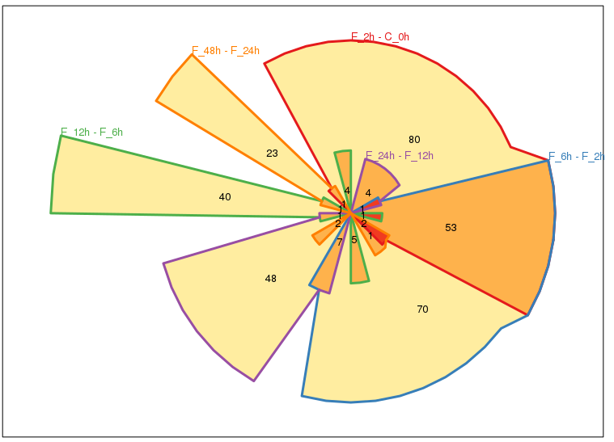

Slide 25
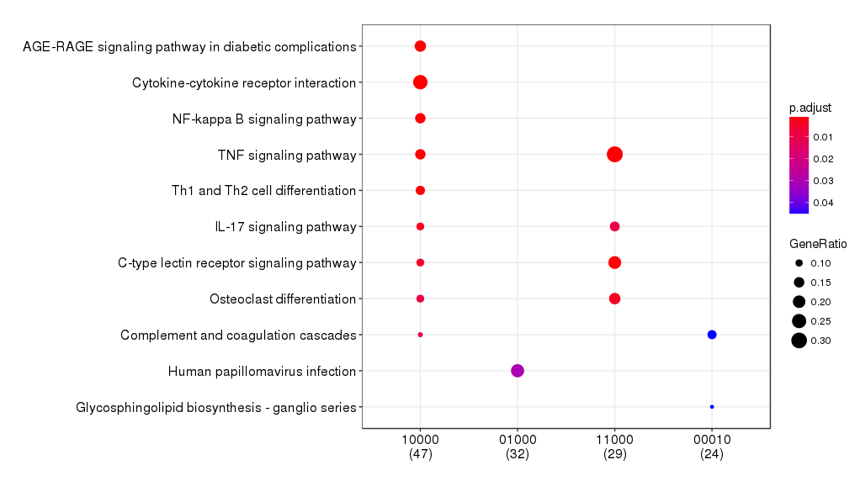
KEGG analysis
F_2h - C_0h, F_6h - F_2h, F_12h - F_6h, F_24h - F_12h, F_48h - F_24h

Slide 26
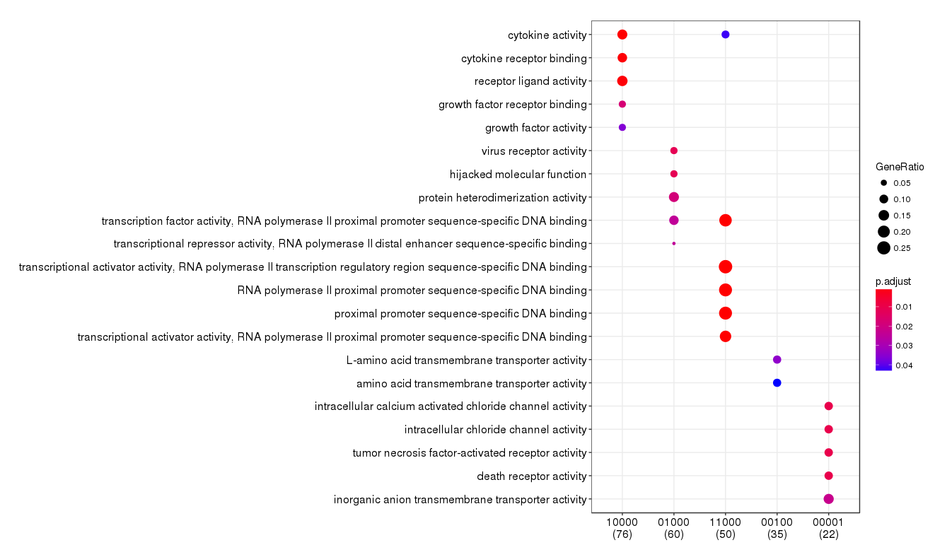
GO analysis

Slide 27
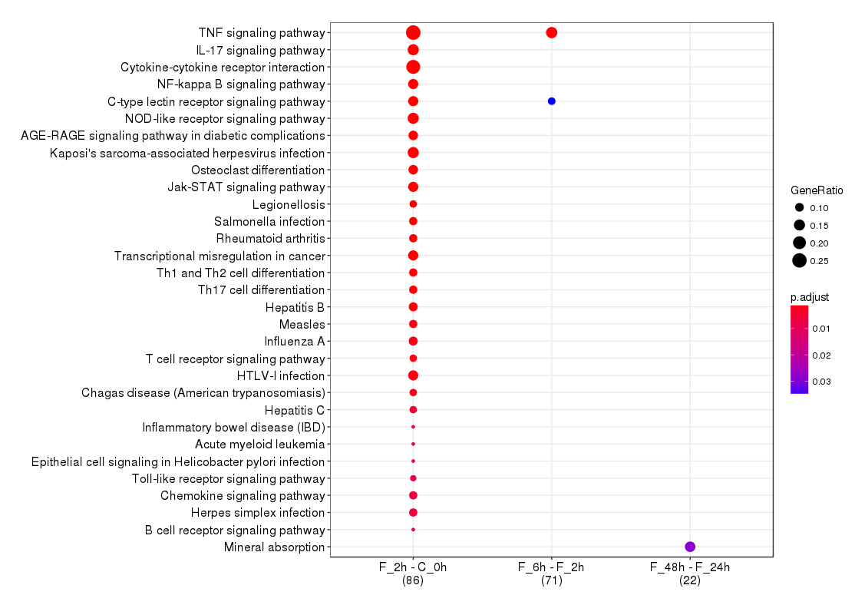
KEGG analysis for time-course DEG (logFC>=2)

Slide 28
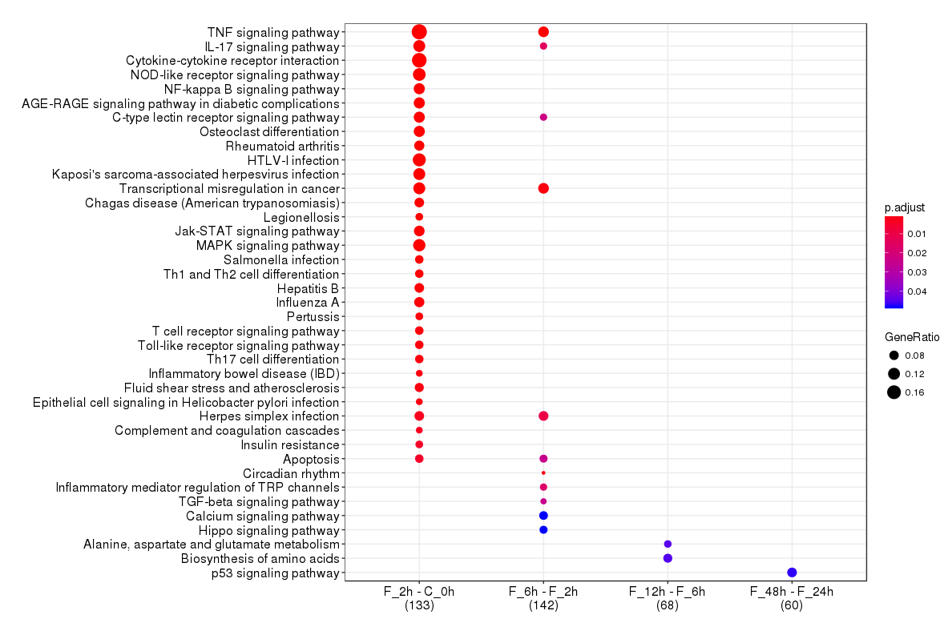
KEGG analysis for time-course DEG (logFC>=1.5)

Slide 29
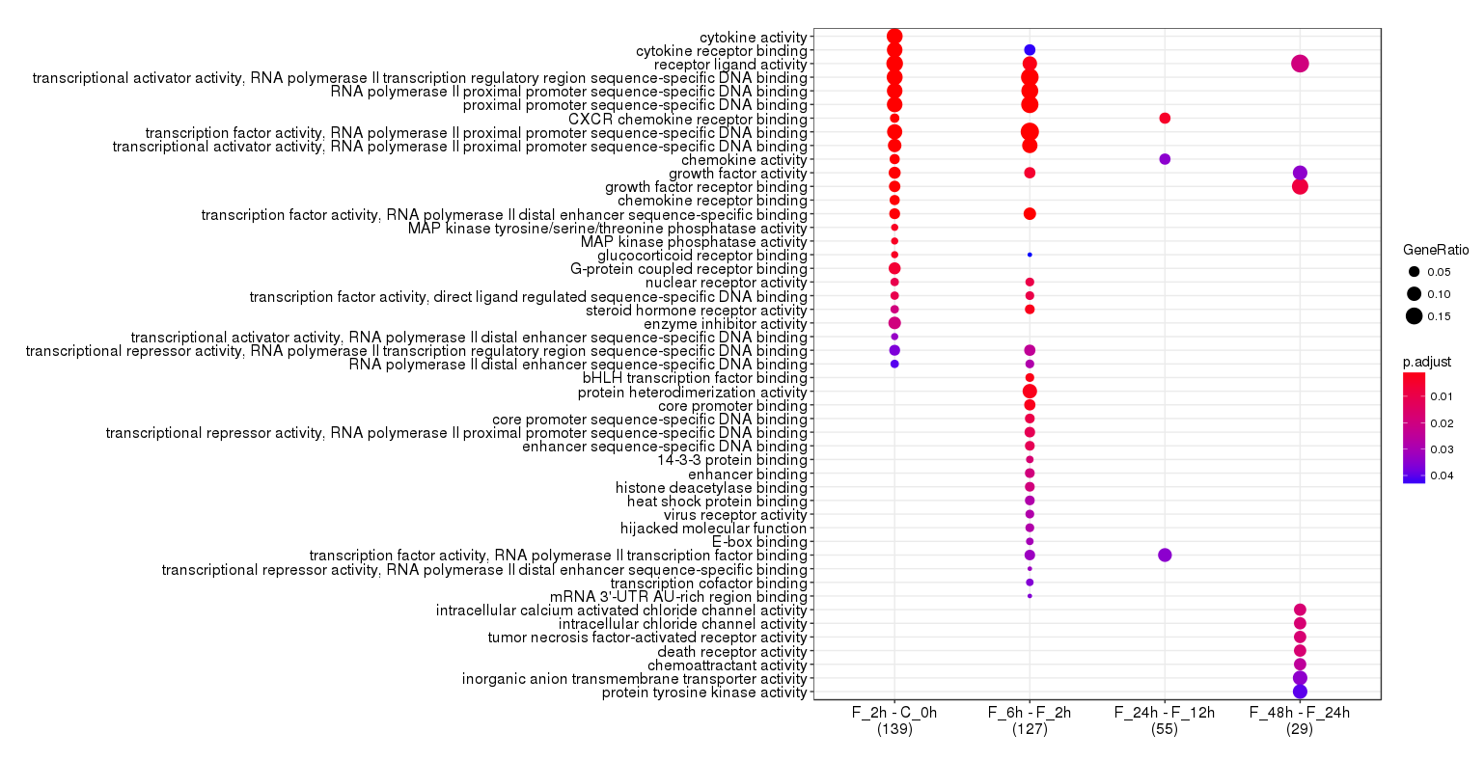
GO analysis for time-course DEG

Slide 30
co-expression analysis
cogena analysis
co-expression analysis
KEGG/GO pathway analysis
GO BP and MF analysis for cluster 2/1

Slide 31
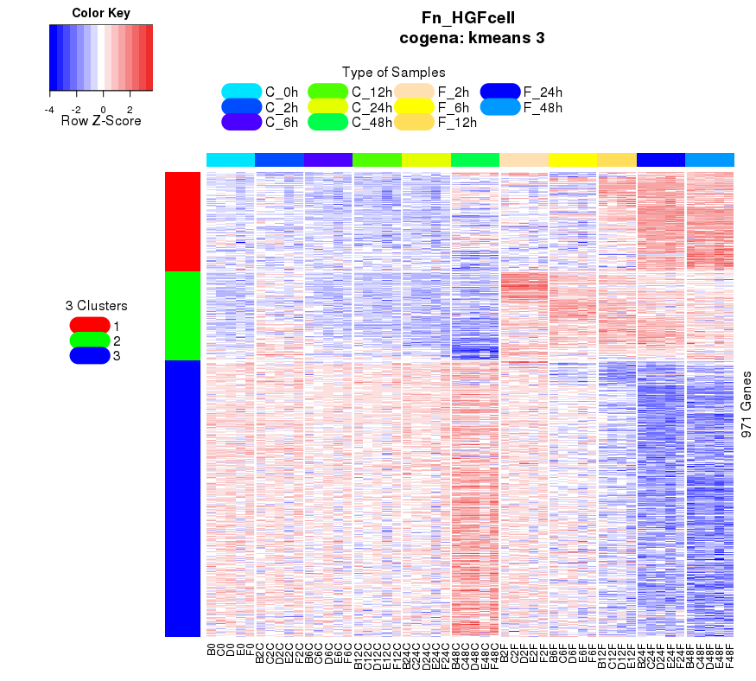
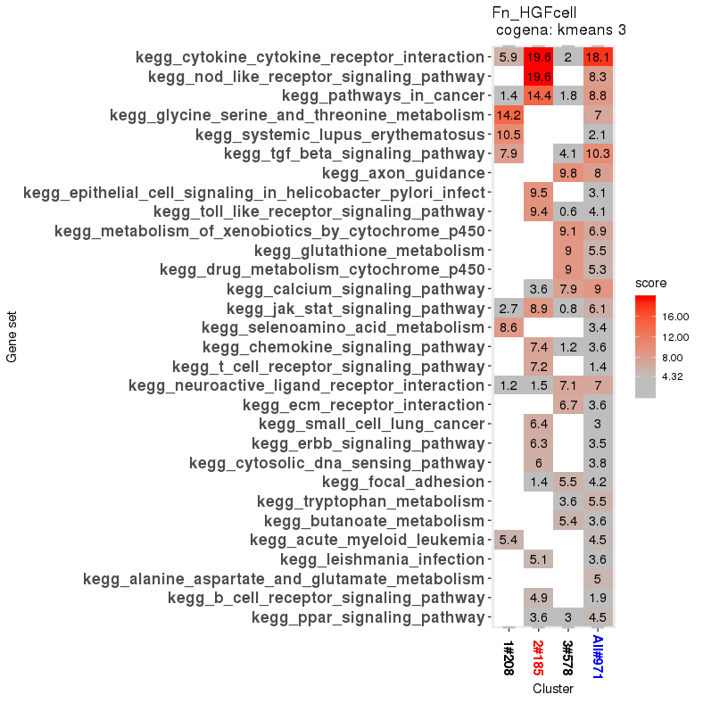
cogena co-expression and KEGG analysis
C1: up after 12h; C2: up immediately; C3: down after 12h

Slide 32
enriched KEGG pathways
C1 (up after 12h):
kegg_glycine_serine_and_threonine_metabolism
kegg_systemic_lupus_erythematosus
kegg_tgf_beta_signaling_pathway
kegg_selenoamino_acid_metabolism
C2 (up immediately):
kegg_cytokine_cytokine_receptor_interaction
kegg_nod_like_receptor_signaling_pathway
kegg_pathways_in_cancer
kegg_toll_like_receptor_signaling_pathway
kegg_epithelial_cell_signaling_in_helicobacter_pylori_infect
kegg_toll_like_receptor_signaling_pathway
kegg_jak_stat_signaling_pathway
kegg_chemokine_signaling_pathway
kegg_t_cell_receptor_signaling_pathway
kegg_small_cell_lung_cancer
kegg_erbb_signaling_pathway
kegg_cytosolic_dna_sensing_pathway
C3 (down after 12h ):
kegg_axon_guidance
kegg_metabolism_of_xenobiotics_by_cytochrome_p450
kegg_glutathione_metabolism
kegg_drug_metabolism_cytochrome_p45
kegg_calcium_signaling_pathway
kegg_neuroactive_ligand_receptor_interaction
kegg_ecm_receptor_interaction
TGF betas cause the transcription of mRNAs involved in apoptosis, extracellular matrix neogenesis and immunosuppression.
The ErbB family of receptor tyrosine kinases (RTKs) couples binding of extracellular growth factor ligands to intracellular signaling pathways regulating diverse biologic responses, including proliferation, differentiation, cell motility, and survival.

Slide 33
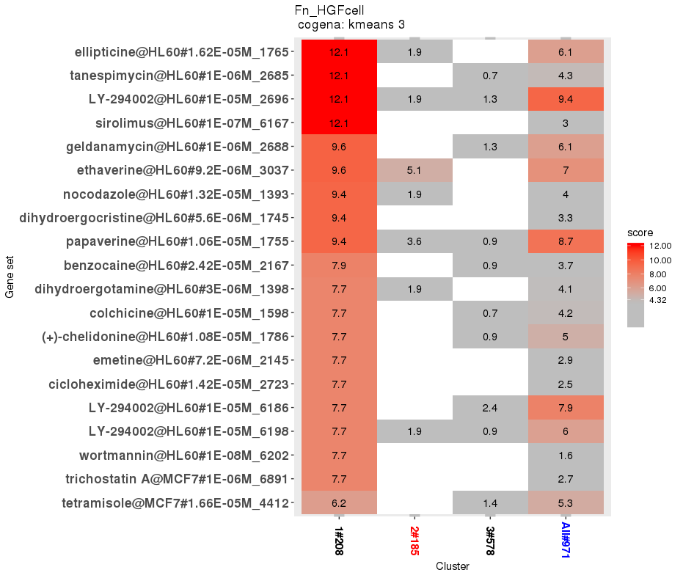
Drug repositioning (C1+CMapDn)
tanespimycin, Geldanamycin: Hsp90 inhibator; antibiotics.
trichostatin: antifungal antibiotic.
Etravirine: treating HIV
Sirolimus: immunosuppressant, inhibits activation of T cells and B cells by reducing their sensitivity to interleukin-2 (IL-2) through mTOR inhibition.
wortmannin, LY-294002: PI3K inhibitor, also inhibit other PI3K-related enzymes such as mTOR, DNA-PKcs, some phosphatidylinositol 4-kinases, myosin light chain kinase (MLCK) and MAPK at high concentrations.
ref Wikipedia

Slide 34
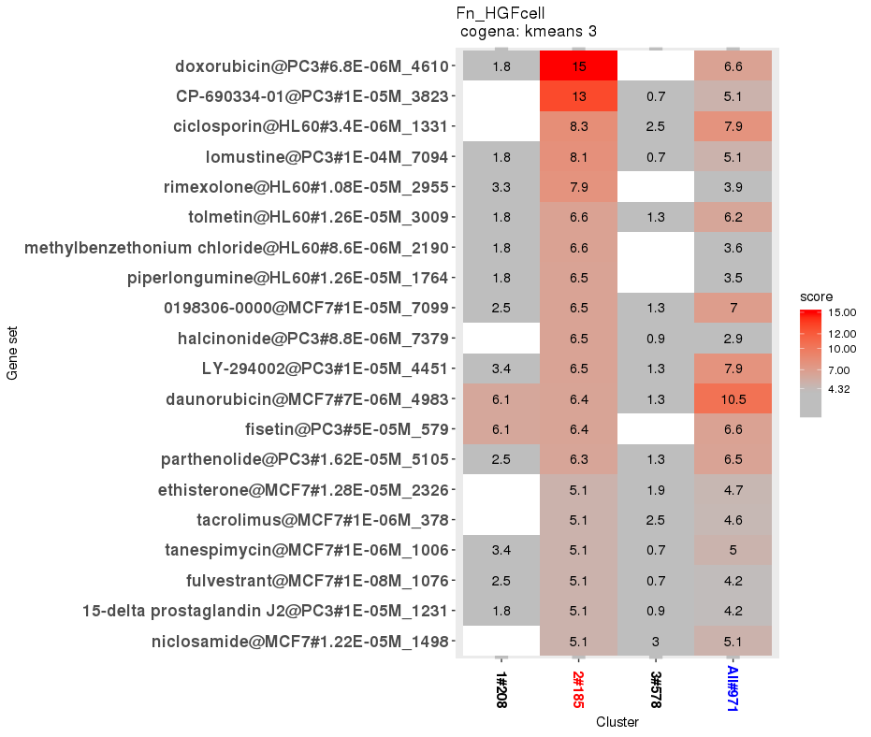
Drug repositioning (C2+CMapDn)
Adriamycin:抗肿瘤抗生素
ciclosporin: immunosuppressant.
Tacrolimus: immunosuppressant，inhibiting the production of interleukin-2, a molecule that promotes the development and proliferation of T cells, which are vital to the body's learned (or adaptive) immune response.
Rimexolone: a glucocorticoid steroid used to treat inflammation in the eye .
tolmetin: non-steroidal anti-inflammatory drug.
tanespimycin, methylbenzethonium chloride: antiseptic.
ref Wikipedia

Slide 35
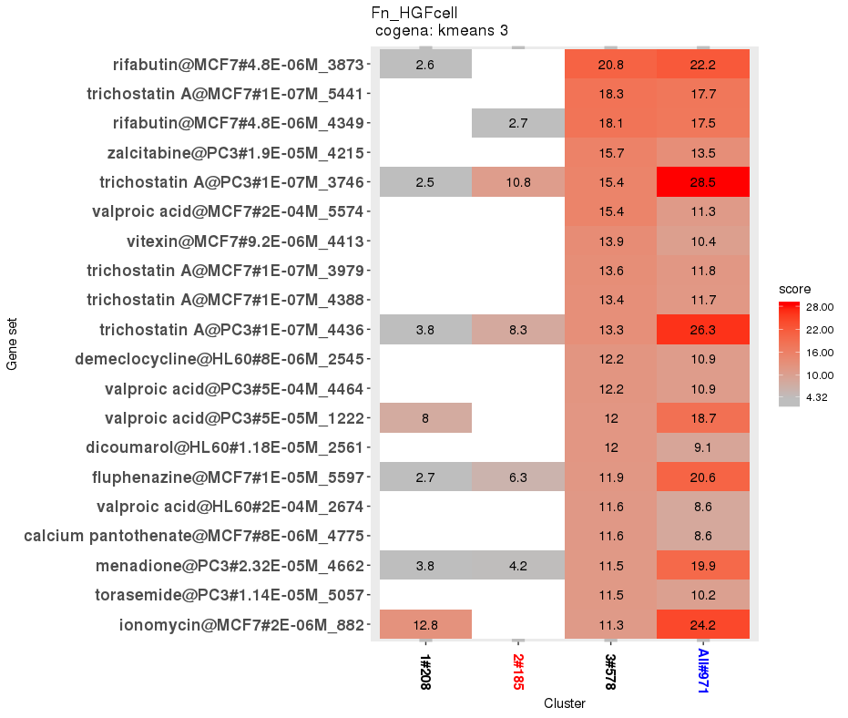
Drug repositioning (C3+CMapUp)
Rifabutin is an antibiotic used to treat tuberculosis and prevent and treat Mycobacterium avium complex.
Trichostatin: an antifungal antibiotic.
Zalcitabine: treatment of HIV/AIDS.
demeclocycline: treat various types of bacterial infections.
Pantothenic acid, also called vitamin B5, synthesize and metabolize proteins, carbohydrates, and fats.
Menadione: occasionally used as a nutritional supplement in animal feed because of its vitamin K activity.
Ionomycin is an ionophore produced by the bacterium Streptomyces conglobatus. It is used in research to raise the intracellular level of calcium (Ca2+) and as a research tool to understand Ca2+ transport across biological membranes. It is also used to stimulate the intracellular production of the following cytokines; interferon, perforin, IL-2, and IL-4 - usually in conjunction with PMA. These cytokines are important in the inflammatory response.
ref Wikipedia

Slide 36
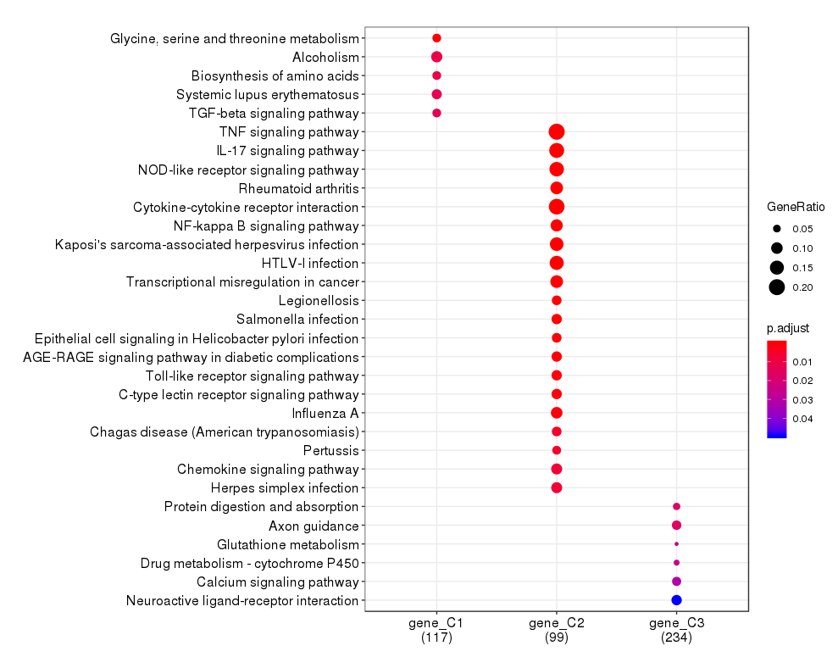
enriched KEGG pathways by compareCluster

Slide 37
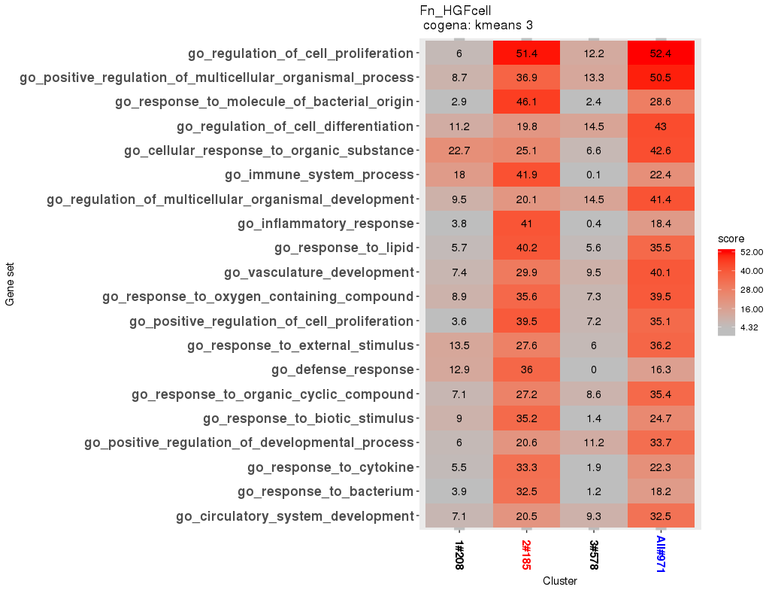
cogena co-expression and GO analysis

Slide 38
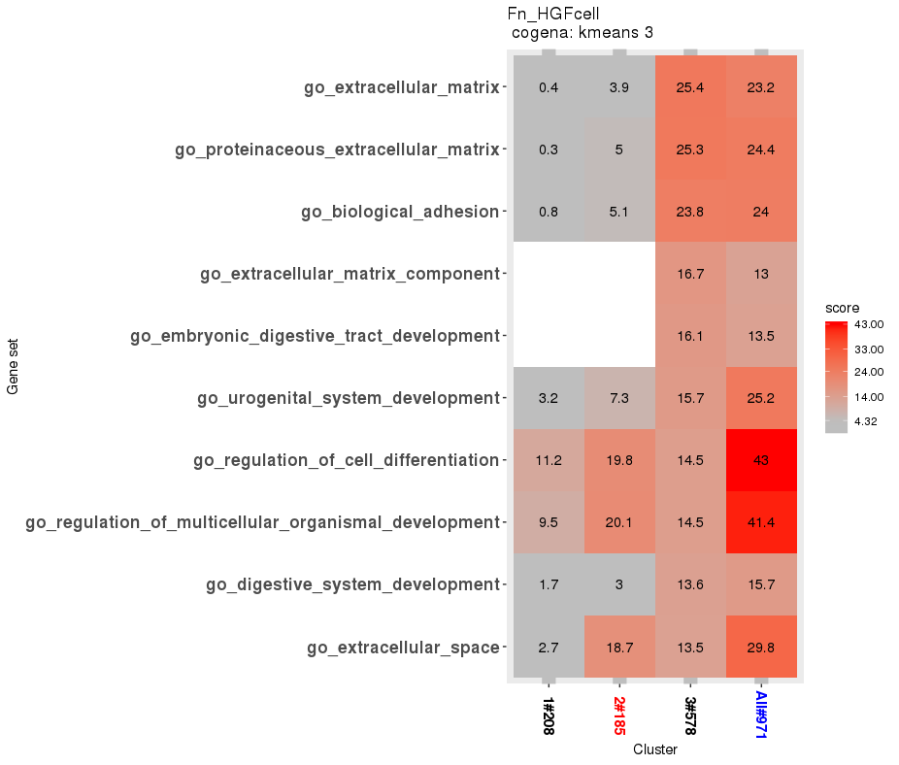
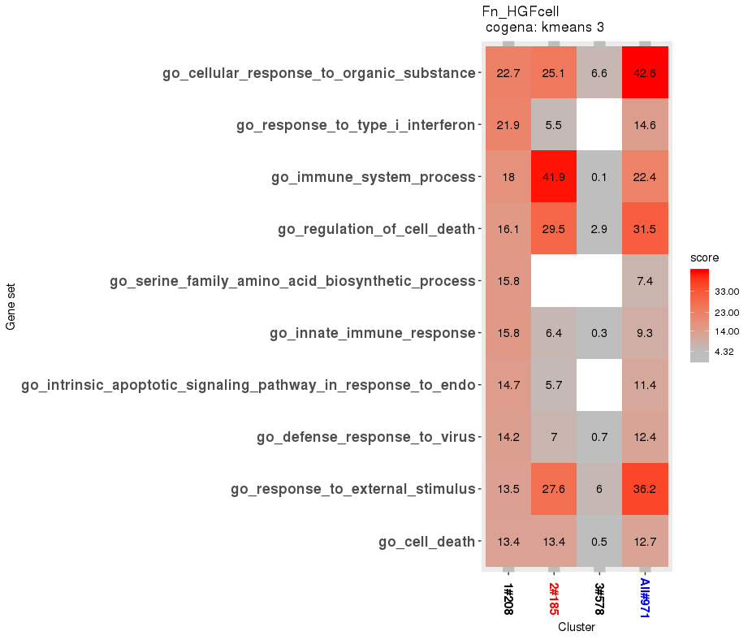
cogena co-expression and GO analysis
ranked by C1
ranked by C3

Slide 39
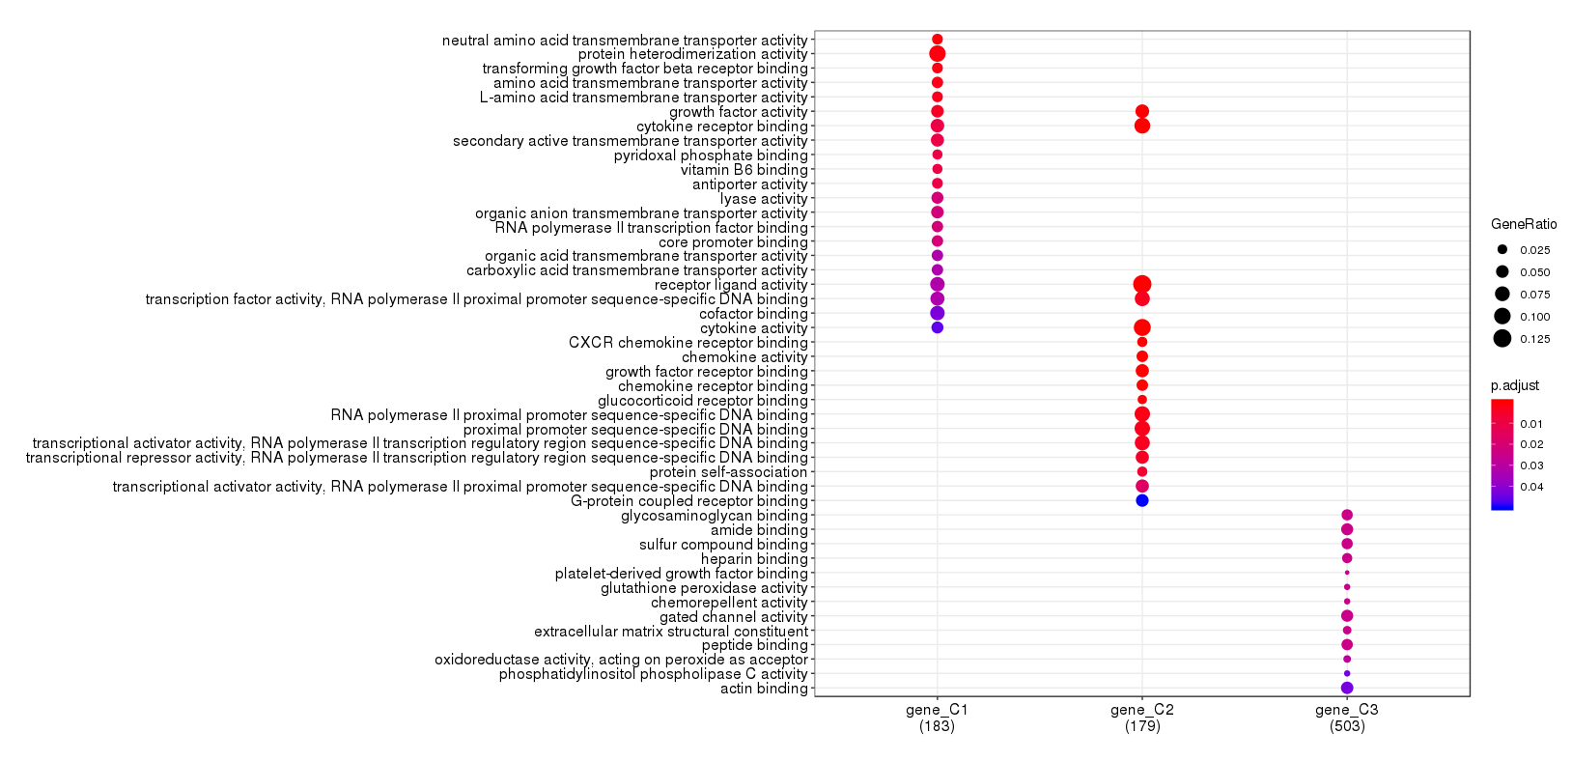
GO analysis based on ClusterProfiler

Slide 40
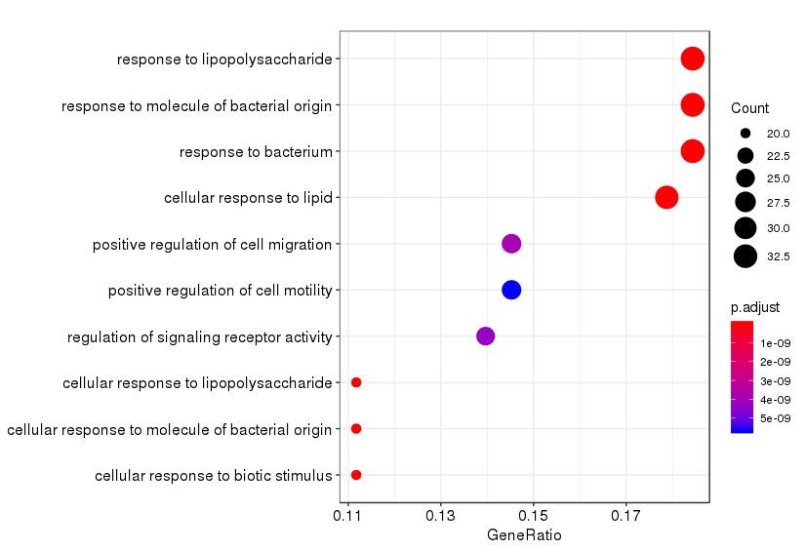
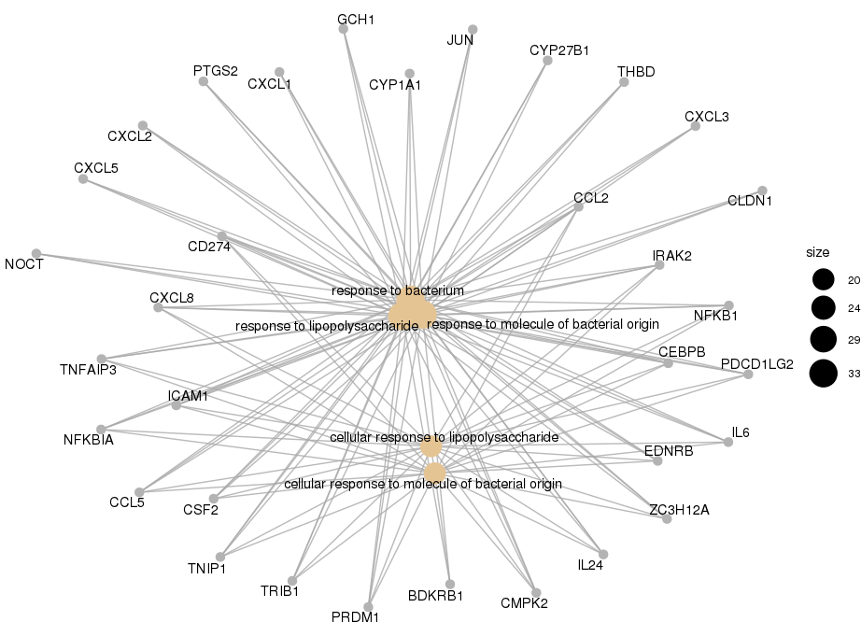
GO BP analysis for cluster2

Slide 41
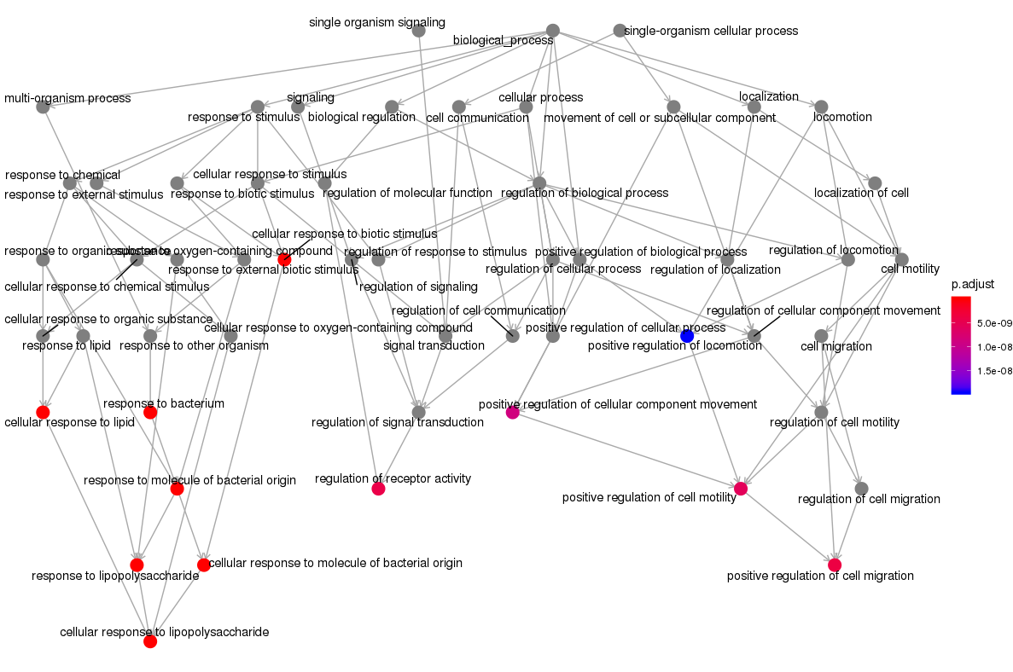
GO BP analysis for cluster2

Slide 42
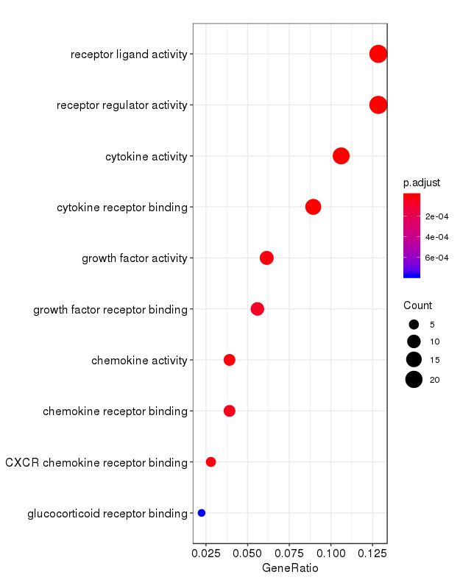
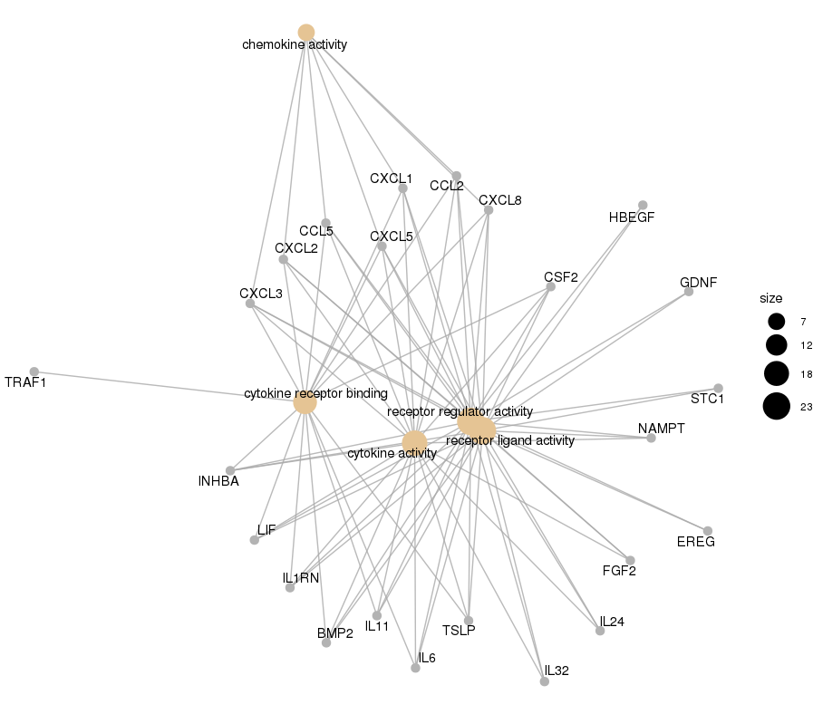
GO MF analysis for cluster2

Slide 43
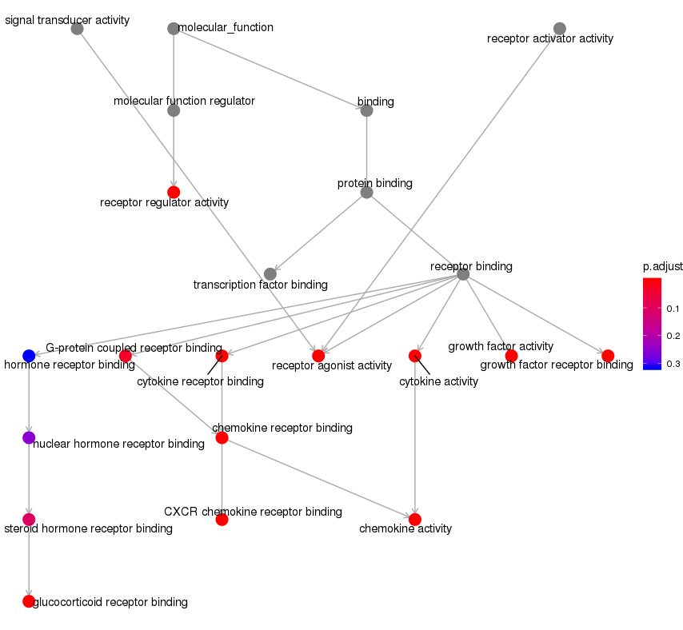
GO MF analysis for cluster2

Slide 44
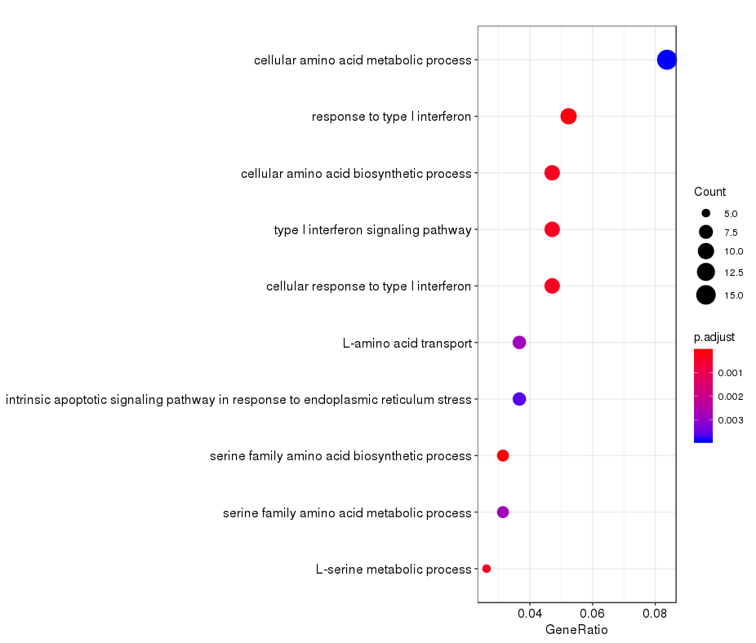
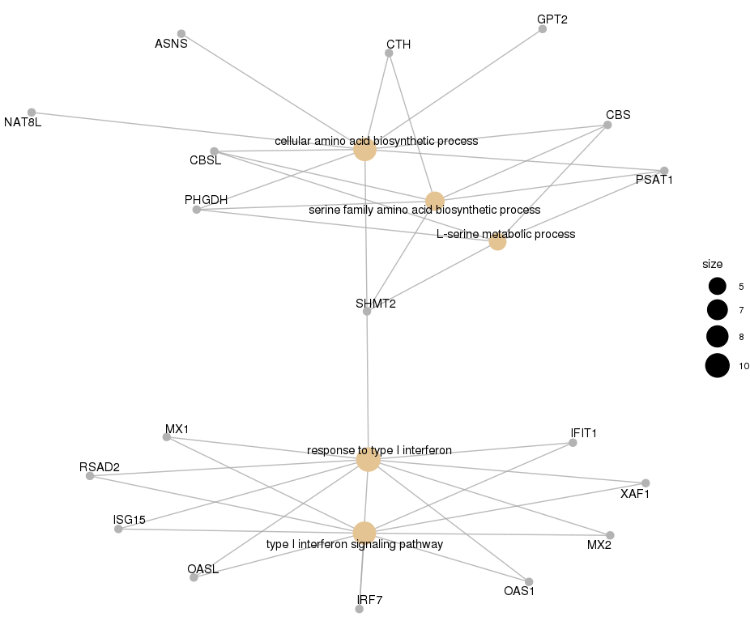
GO BP analysis for cluster1

Slide 45
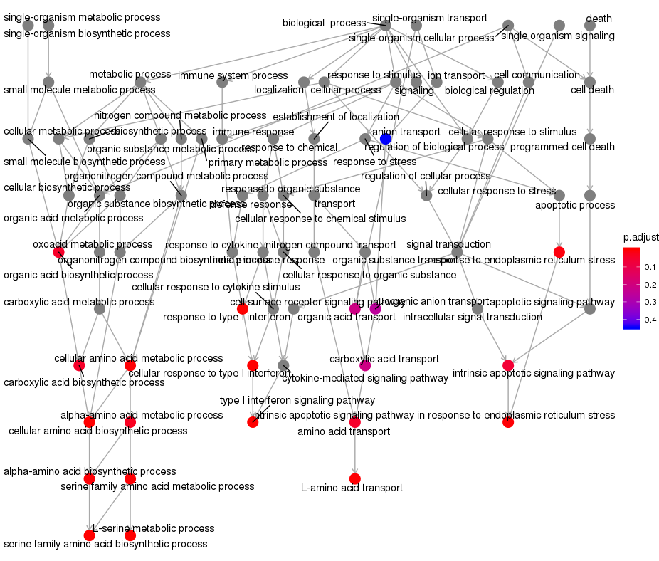
GO BP analysis for cluster1

Slide 46
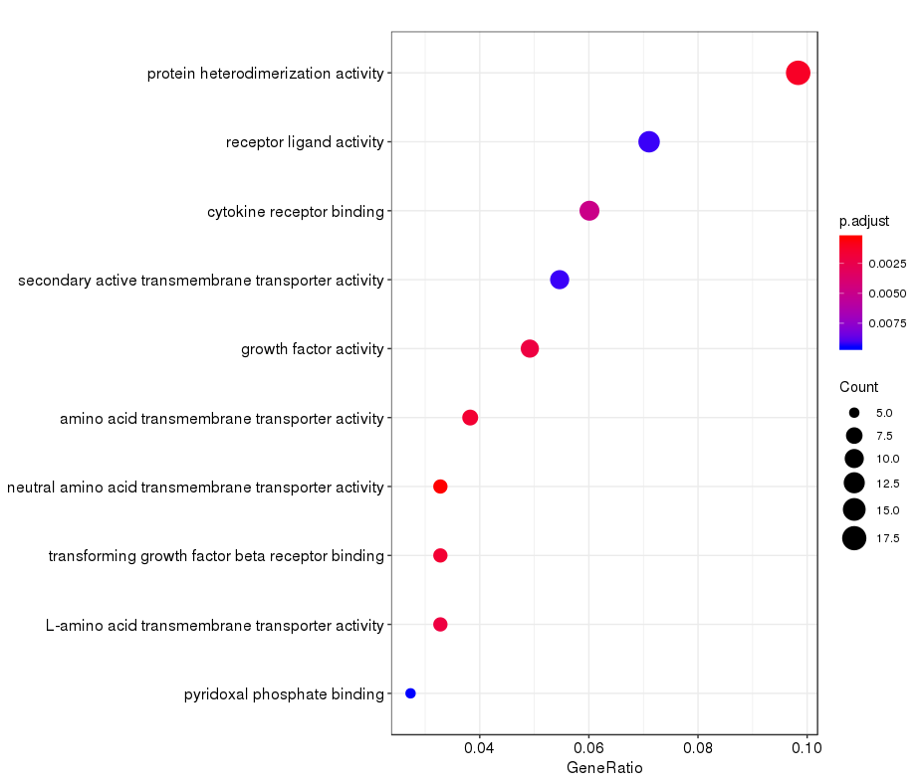
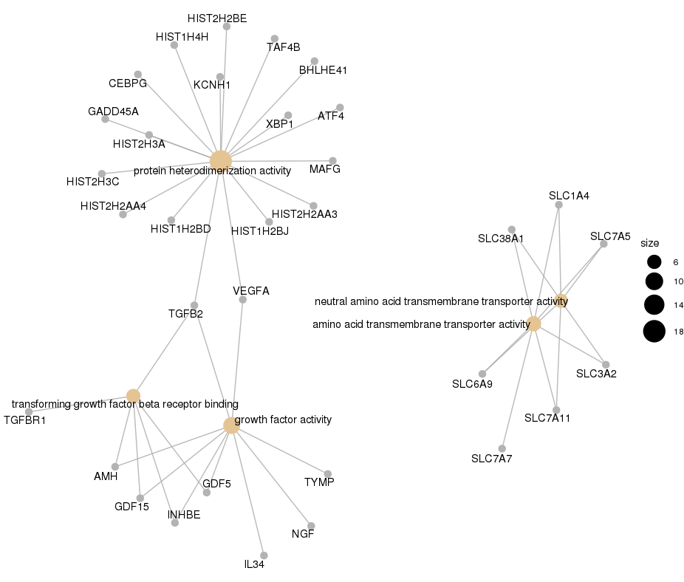
GO MF analysis for cluster1

Slide 47
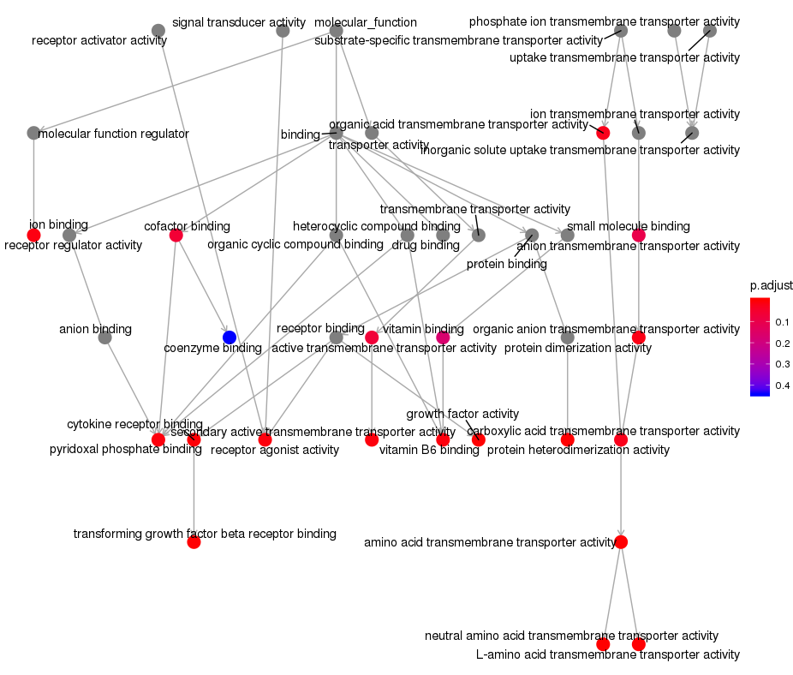
GO MF analysis for cluster1

Slide 48
Enrichment analysis for 24h only
heatmap
Pathway analysis (KEGG, MSigDB_C2, GSEA)
GO analysis (BP, MF)
cogena analysis
heatmap
pathway

Slide 49

Analysis at 12h

Slide 50

KEGG

Slide 51

C2_all_pathway

Slide 52

GSE analysis

Slide 53

GO_bp

Slide 54

GO_bp

Slide 55

GO_MF

Slide 56

GO_MF

Slide 57

cogena_heatmap

Slide 58
cogena_pathway

Slide 59
Changes of pathway enrichment (GSEA) via time
using time-indep data (t-statistic)
GSEA
enriched (up or down-) pathways for up or down-regulated genes per timepoint
heatmap

Slide 60


See heatmap_pathway.pdf
immue-related pathways

Slide 61

See heatmap_pathway.pdf
metabolite-related pathways

